Slide 1
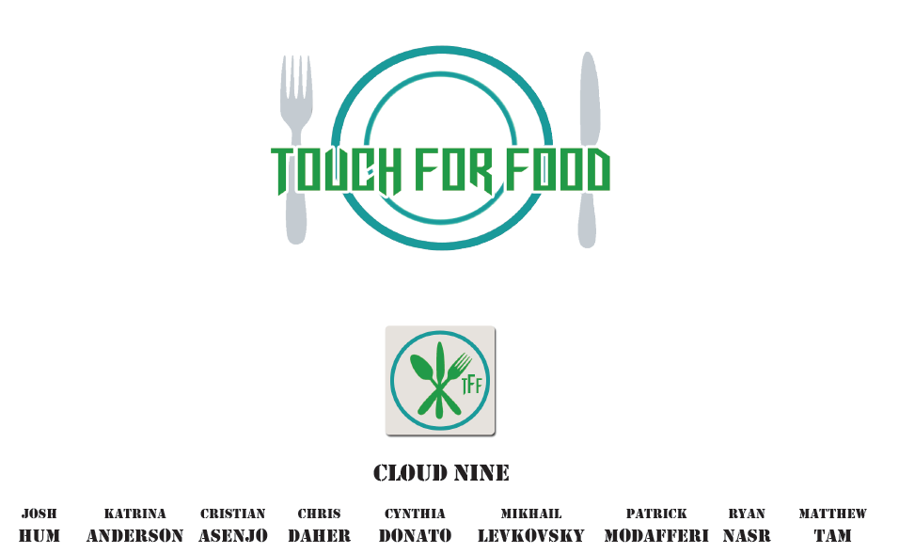
Technical Presentation

Slide 2
Agenda
Introduction to Touch For Food
Project Plan
Risk Management
Critical Requirements
Traceability
Architecture
The Process
Verification and Testing
Artifact Management

Slide 3
Touch For Food
The idea
Waiter-reduced dining experience
User data collection
Allow restaurant to better serve their clients
NFC and QR Codes
Allows customers to log in using mobile devices
Creates a session between restaurant and user
Table ID
User ID

Slide 4
Project plan
Effort
Budgeted 414 person-hours per week
Too high. Adjusted goal to 200 person-hours per week.
Schedule
Activity-on-node diagram
Discussed during the planning of each iteration.
Adjusted according to the priority of tasks

Slide 5
Project plan
Skills
Although everyone did some of everything, when deadlines were tight, the person with the best ability to complete a particular task was assigned the task.
Resources
Jira
Visual Studio
SVN

Slide 6
Project plan
Monitoring and Control
Monitored how close we were to schedule.
To get back on track:
Increase person-hour effort
Increase organization
Create clear roles for each iteration (QA, Bug Basher, etc.)
Take advantage of each team member’s skill set

Slide 7
Risk management
Risk planning/monitoring
Potential risks re-evaluated at the beginning of each iteration for both short-term and long-term
Used past projects and experience to identify potential risks

Slide 8
Risk management
Identified risks
Schedule slips (missed scheduled deadlines)
Procedural risks (conflicting priorities)
Lack of adequate testing
Conflicting responsibilities (other classes, work, etc.)
Defect insertion while making “minor” changes (end of project)
Budget
Lost stakeholder/no restaurant stakeholder

Slide 9
Risk management
Risk Control
Schedule slips (contingency measures)
Procedural risks (mitigation)
Lack of adequate testing (contingency measures)
Conflicting responsibilities (reduction through scheduling)
Defect insertion while making “minor” changes (avoidance)
Budget (acceptance)
Lost stakeholder/no restaurant stakeholder (contingency measures/acceptance)
Prioritized risks according to impact/likelihood

Slide 10
Critical Functional Requirements for Customers
Place orders
Manage bills
Call for service
Manage profile
Review past meals
Notes:
Place orders: Allow customer to place food orders to the restaurant
Manage bill: Distribute the ordered items into different bills
Call for service: Allow customer to request a waiter come to the table
Manage profile: Allow customer to change their personal information
Review past meals: Allow customer to leave reviews and ratings on their past meals

Slide 11
Critical Functional Requirements for Restaurants
Manage menus
Manage items
Manage bills
Obtain statistical reports
Notes:
Manage menus: Allow the restaurant to manage multiple menus according to current needs
Manage items: Allow the restaurant to manage the items listed in menus.
Manage bills: Allow the restaurant to distribute the ordered items into different bills
Obtain statistical reports: Allow the restaurant to obtain statistical reports on ordered items and waiter performance

Slide 12
Critical Non-Functional Requirements
Mean Time Between Failure
Response time
Simultaneous orders within one restaurant
Concurrent users browsing the system
Notes:
MTBF: Should be no less than 10 months
Response time: Should not exceed 10 seconds
Simultaneous orders: Up to 25
Concurrent users: As many as 200 without performance loss

Slide 13
Validation of requirements
Jira sets each task’s id
User story id used to provide traceability throughout the documents
User story id used to link user story to Use Cases (UC), System Sequence Diagrams (SSD), System Operations (SO), Operational Contracts (OC), Sequence Diagrams (SD) and Test Cases (TC)
Done by appending user story id to artifact’s acronym.

Slide 14
Validation of Requirements
Provides an easy way to trace all requirements through the various documents and find the correct artifact.
Traceability matrix also provides a system wide view
NFRs assigned an id in Supplementary Specifications which can be used to trace the NFR in other documents.

Slide 15
Architecture
Touch For Food is a Web Based MVC application (sort of).
The MVC architecture was extended to use an extra component called the View Model Model.
The Web component used the REST architecture.

Slide 16
Why MVC (sort of)?
MVC promotes separation of concerns.
Views are thin clients, models are table data gateways, controllers had most of the logic.
While Touch For Food is an MVC application it was built on top of an N-Tier architecture.
Allowed for the common functionalities to be factored out.

Slide 17
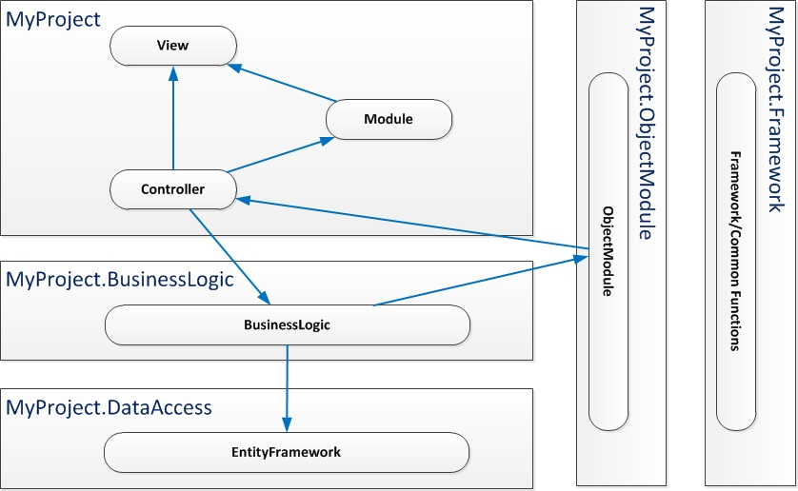
MVC explanation

Slide 18
REST vs SOAP
REST is less coupled then SOAP.
REST has an emphasis on readability
REST does not require the passing and parsing of XML.
This means less data is being passed, which is crucial since Touch For Food is a mobile application.

Slide 19
Verification – Peer Review & Improvements
Peer Review
Done before committing large changes
Using Assembla & Tortoise SVN
Improvements
Distinct task type in JIRA
Often introduced during team meetings.

Slide 20
Verification - Testing
Unit Testing
Amount: 230
Statement Coverage (Blocked Base)
Project : 51.44%
Controller Layer : 55.74%
Mapper Layer: 73.36%
UI Testing
Amount: 45
Platforms
Google Chrome - 26.0.1410.43 m
Samsung S3 - Android 4.1.13
iPhone 4 – iOS 6.1
* Tests are regressive

Slide 21
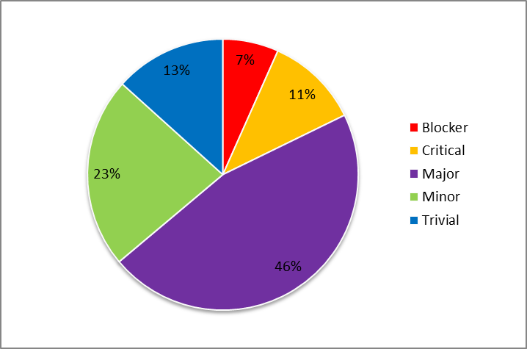
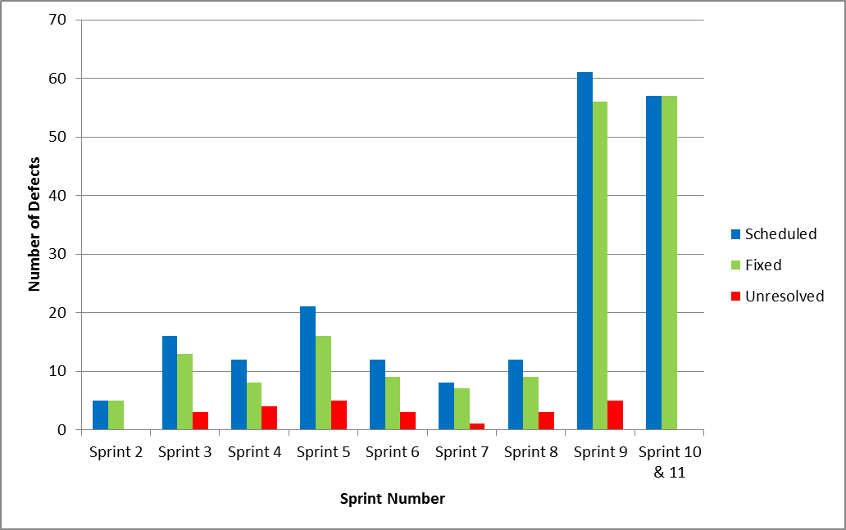
Verification - Defects
Number of Defects vs. Criticality
Defects vs. Sprint
Criticality | Number of Defects
Blocker | 12
Critical | 20
Major | 83
Minor | 41
Trivial | 24
Total | 180
Defect Removal Effectiveness Percentage (DRE): 88.24%
Test Case Design Efficiency Percentage (TDE): 65.45%

Slide 22
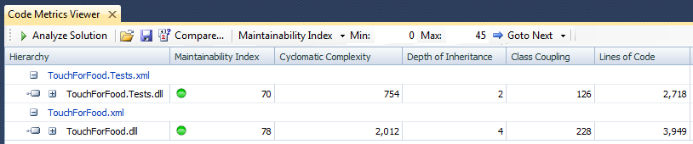
Verification – Code Quality
Analysis Tool: Code Metrics Viewer
Analysis Tool: Code Metrics Viewer
Measures
Maintainability Index: Good Standing
Cyclomatic Complexity: Good Standing
Depth of Inheritance: Good Standing
Class Coupling: Good Standing
Lines of Code: Good Standing

Slide 23
Process
Iterative development cycle (Agile)
Weekly meetings
Two week sprints
Why Agile?

Slide 24
Selecting a Process
Team Perspective
Project Perspective

Slide 25
Team Perspective
Nine members
Different schedules
Game/Web concentrations
Part time jobs
Other projects
Timeboxing forces members to work

Slide 26
Project Perspective
TFF is a proof of concept
Lack of expertise in restaurant domain
Requirements were never set in stone
New technology
Risks needs to be addressed

Slide 27
Other Iterative Development Models
Spiral
Rapid
Cleanroom
Unified Process (framework)

Slide 28
Artifacts Management
Models
Source code
Documentation
Stories and process

Slide 29
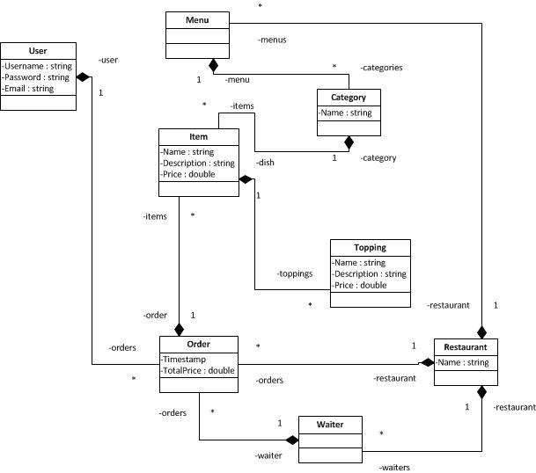
Artifacts: Models
Models generated by Visual Studio
Stored in SVN repository

Slide 30
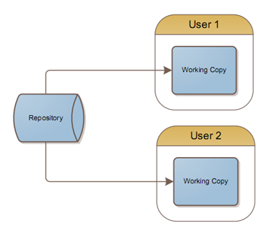
Artifacts: Source code
Stored in SVN repository hosted by Assembla¹
Use of branches for feature development
¹ http://www.assembla.com

Slide 31
Artifacts: Documentation
Stored in SVN repository hosted by Assembla¹
Created using Microsoft Word
Use of Word templates to keep consistency across all documents.
Split into:
Requirements
Analysis
Architecture
Management
Traceability
Test Report/Plan
User Interface Requirements
Installation Guide
User Manual

Slide 32

Artifacts: Stories and process
Use JIRA¹ to manage:
Stories
Defects
Sprints
Improvements
Time
¹http://www.atlassian.com/software/jira/overview

